Slide 1
Generating the next EDM hit song
Prepared by Danil Meresenschi

Slide 2
Contents
01. Problem Statement
02. Data Information
03. Data Retrieval
04. Date Pre-Processing
05. Model Architecture
06. Model Outcome
07. Result Evaluation
08. Future Work

Slide 3


Problem Statement
Some believe that utilizing AI system in artistic disciplines recedes the inherent value of the process of creation and ultimate product of those efforts. The music industry, however, is an ever-evolving domain that drastically changes as a result of innovations of any sort.
Advancements in leveraging AI for music generation could be revolutionary and ultimately lead to new ingenious approaches to the art. The cooperation of advanced machine systems and the creative capacity of the human mind can become the status quo of the musician of tomorrow.

Slide 4
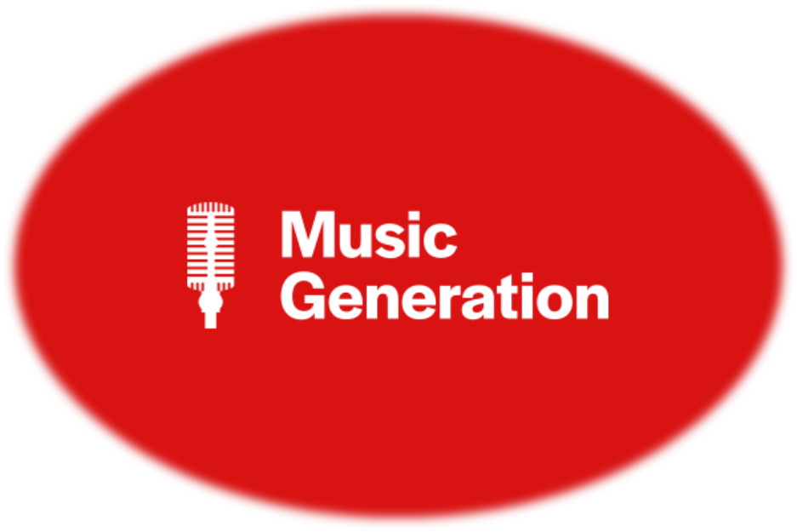
Problem Statement
As an avid electronic music fan and a hobbyist DJ, I am passionate about the every technical compound that goes into creating captivating EDM music. To extract the best patterns for the model to learn from, it is necessary to write a bot to crawl the web and download some of the best compositions in the genre in MIDI(.mid) format.
Due to an LSTM model’s capacity to remember long-term dependencies and adequately yield sequenced predictions, it will be utilized in this project. The goal is to generate well-structured melodies with coherent rhythmic patterns and transitions.

Slide 5

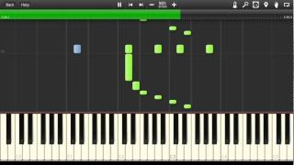
Data Information
Audio Version
MIDI (Musical Instrument Digital Interface) is a protocol communicate musical data to devices with the capacity to read MIDI files, which don’t contain actual digital audio data. It could be perceived as sequenced instruction of when to play what instrument and for how long.
MIDI Version
MIDI files are high-level, structured, and symbolic representations of music, while audio files are low-level, unstructured, and direct recordings of sound. Audio files contain data such as waveform, treble, etc.
MIDI structure can be processed and transformed to adequately fit as LSTM inputs.

Slide 6
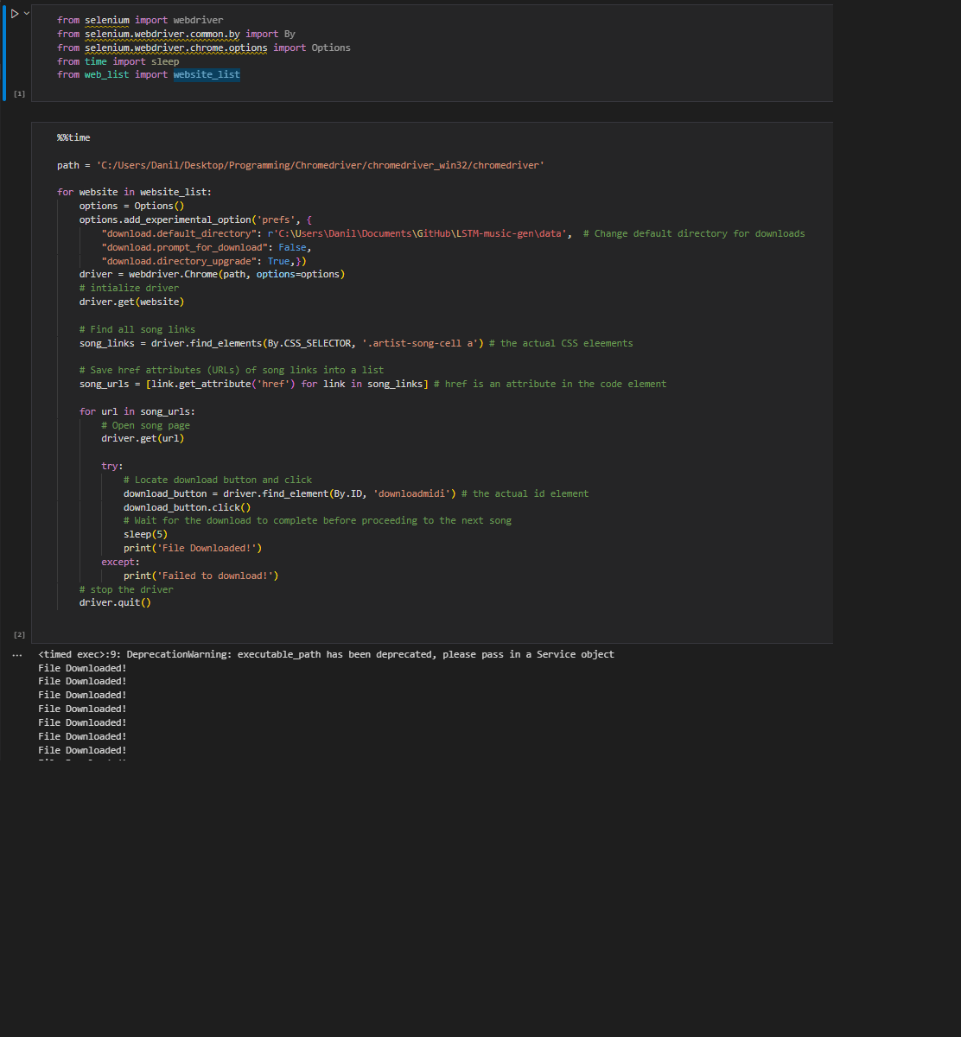
Data Retrieval
To cater custom data for training, I developed a Selenium powered web-scraper to download MIDI recordings of the songs created by household names in the EDM genre.
Web-Scraper Bot Demo
The bot was designed to navigate through designated URLs and interact with JavaScript elements to execute commanded actions, such as downloading a file.

Slide 7
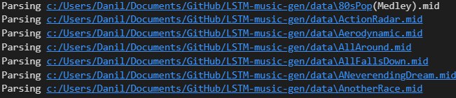
Date Pre-Processing
The scrapped midi files needed to be further dissected into notes and chords, and then aggregated into a single file in a string format. This is necessary in order to be able to transform those sequences into the adequate input format for the LSTM model.
It is crucial to properly pre-process the midi files and transform the data into a format that is appropriate for the inputs. In case of a blunder the entire training process could be compromised due to wrongful sequencing and structuring.
🎶
Notes File

Slide 8
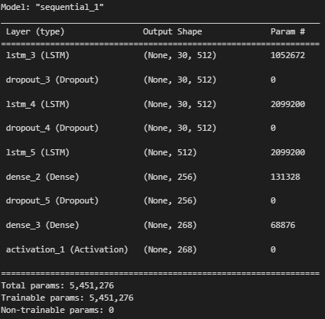
Model Architecture
The model’s built involves a taylored combination of added layers to effectively predict on the premise of midi data. The model has stack layered LSTMs, Dropout layers to prevent from overfitting, and the Dense layers to connect every neuron among all layers and change the vector’s dimensions.
There is an Activation layer with the softmax function to normalize the output and convert it into a probability range from 0 to 1. Then the LSTM is compiled with the categorical_crossentropy loss function and RMSprop optimizer.

Slide 9

Model Outcome
1 epoch Model Parameters:
Training Notes Sequence = 30
Batch Size = 32
Epochs = 1
Final Details:
Training Time = 1 hour 16 minutes
Loss = 4.2371
File Path:
LSTM-music-gen/model/generate_midi_1ep.mid
generate_midi_1ep.mid
20 epoch Model Parameters:
Training Notes Sequence = 30
Batch Size = 32
Epochs = 20
Final Details:
Training Time = 26 hours
Loss = .63
File Path:
LSTM-music-gen/model/generate_midi_20ep.mid
generate_midi_20ep.mid

Slide 10
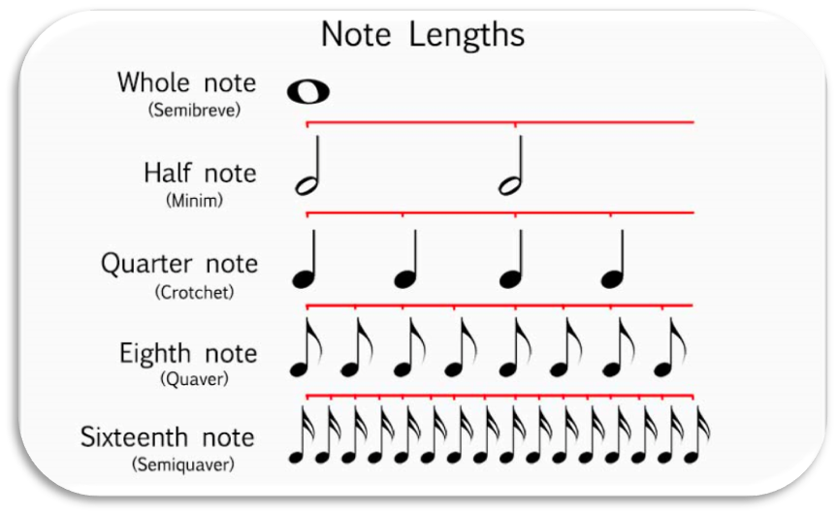
Result Evaluation
Neither the single epoch model nor the 20 epoch model were able to capture a great deal of complexity to yield promising generations. The underwhelming results might have been caused by the extensive variety of instruments present in the compositions on which the model was trained on.
The only difference between the generated files appeared to be the notes and pitch in the sequence, while no complex patterns and transitions were observed. Most likely, however, the issue was the short training sequence length of only 30 notes. It might have simply not been enough for the model to form longer-term dependencies.

Slide 11
Future Work
I could have implemented EarlyStopping and ModelCheckpoint functionality to have more control over the training process and save the best model weights for subsequent work.
A more conservative batch size would have resulted in more granular learning, hence a better model, at the expense of greater computational cost.
Increasing epoch size would have allowed the model to learn in greater depth, which would have yielded better results at the greater risk of the model to start exhibiting overfit patterns. This potential issue could have be potentially addressed by adding more Dropout layers to scale up the mode’s ability to generalize.
While further experimenting with longer training note sequences, it became apparent that it a very significant factor in instilling various pattern for the model to learn from. The resulted repetitiveness in the generate outcomes might have been a result of the model not learning on enough patterns to then compile a coherent melody.
In the scenario, where an adequate EDM composition is created, an interesting implementation would be synthesizing the MIDI file through the use of the midi2audio library functionality and various SoundFont templates to structure the audio file. This would allow to listen to the generated song as an audio file tuned to a specific instrument.

Slide 12
Thank you for the amazing quarter!
🎼🎶

